Slide 1
Module 1.4
Defense Against Control Hijacking – Platform Defenses

Slide 2

Platform Defenses
Control Hijacking

Slide 3
Preventing hijacking attacks
Fix bugs:
Audit software
Automated tools: Coverity, Prefast/Prefix.
Rewrite software in a type safe languange (Java, ML)
Difficult for existing (legacy) code …
Concede overflow, but prevent code execution
Add runtime code to detect overflows exploits
Halt process when overflow exploit detected
StackGuard, LibSafe, …

Slide 4
Marking memory as non-execute (W^X)
Prevent attack code execution by marking stack and heap as non-executable – DEP – Data Execution Prevention
NX-bit on AMD Athlon 64, XD-bit on Intel P4 Prescott
NX bit in every Page Table Entry (PTE)
Deployment:
Linux (via PaX project); OpenBSD
Windows: since XP SP2 (DEP)
Visual Studio: /NXCompat[:NO]
Limitations:
Some apps need executable heap (e.g. JITs).
Does not defend against `Return Oriented Programming’ exploits
Notes:
/NXCOMPAT: tells linker that app is compatible with DEP. :NO indicates don’t use DEP.
DEP: data execute prevention

Slide 5
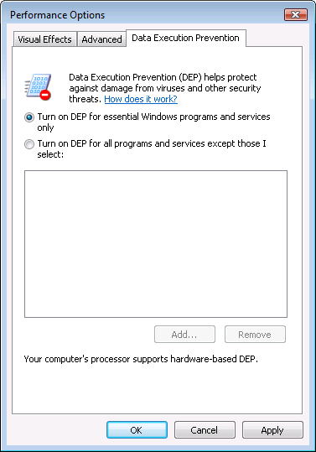
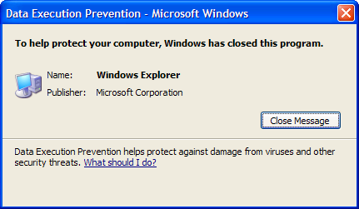
Examples: DEP controls in Windows
DEP terminating a program

Slide 6
Attack: Return Oriented Programming (ROP)
Control hijacking without executing code
stack
libc.so
args
ret-addr
exec()
sfp
printf()
local buf
“/bin/sh”
Notes:
NX wasted effort?

Slide 7
Response: randomization
ASLR: (Address Space Layout Randomization)
Map shared libraries to rand location in process memory
⇒ Attacker cannot jump directly to exec function
Deployment: (/DynamicBase)
Windows 7: 8 bits of randomness for DLLs
aligned to 64K page in a 16MB region ⇒ 256 choices
Windows 8: 24 bits of randomness on 64-bit processors
Other randomization methods:
Sys-call randomization: randomize sys-call id’s
Instruction Set Randomization (ISR)
Notes:
Combination of NX and ASLR is effective.
/DynamicBase: Visual Studio flag to indicate that application works with ASLR.

Slide 8
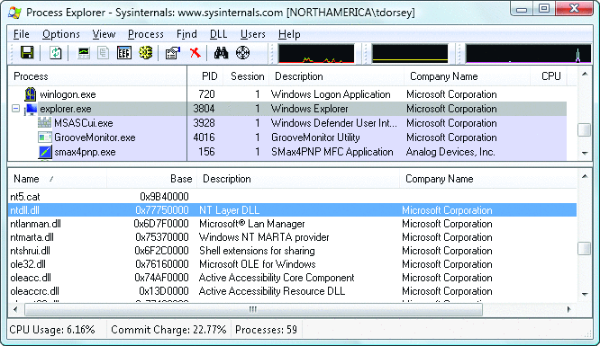
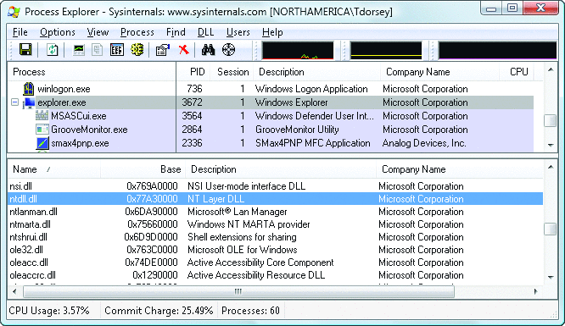
ASLR Example
Booting twice loads libraries into different locations:
Note: everything in process memory must be randomized
stack, heap, shared libs, base image
Win 8 Force ASLR: ensures all loaded modules use ASLR

